Slide 1
Unit 3: Waves Sound
Mr. Le
Fall 2017

Slide 2
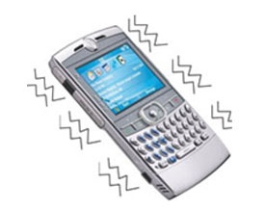
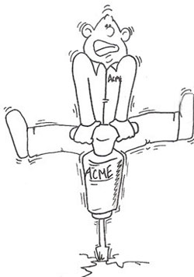
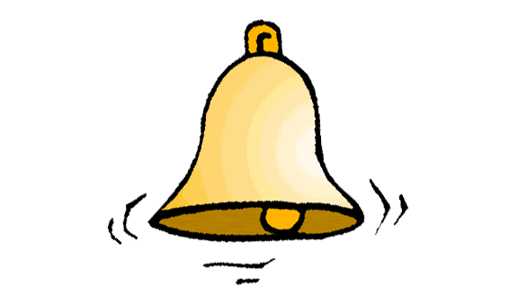
Sound Waves
Sound: is produced by vibrations.

Slide 3
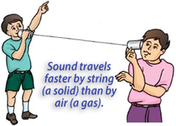
Recall!!
Sound is
a mechanical wave
a compressional wave where air molecules move back and forth in the direction of the wave.
travels the fastest in solids and slowest in gases

Slide 4
Pitch
Pitch- how high or low a sound seems
Low Pitch, deep sound
http://www.youtube.com/watch?v=zDiutG9O4Q0
High Pitch, squeaky sound
http://www.youtube.com/watch?v=kc8WZbAWE1w

Slide 5
Loudness
Loudness: how much energy we think a sound wave carries
If you are increasing the volume of a sound, you are increasing its loudness.

Slide 6
Unit 3: Waves Relationships
Mr. Le
Fall 2017

Slide 7
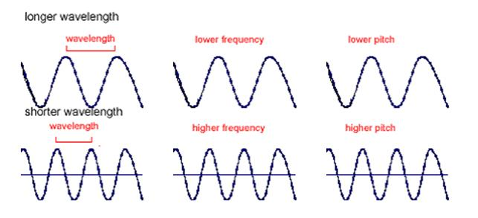
Relationships
Frequency has a direct relationship with pitch.
The higher the frequency, the higher the pitch.
The lower the frequency, the lower the pitch.

Slide 8
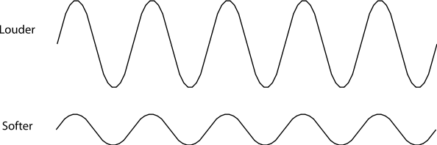
Relationships
Loudness has a direct relationship with amplitude.
The louder the sound, the higher the amplitude.
The softer the sound, the lower the amplitude.

Slide 9
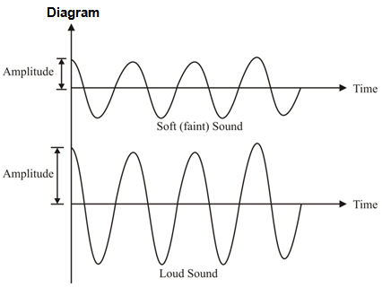
Relationships
Softer Sound = Lower Amplitude = Lower Energy
Louder Sound = Higher Amplitude = Higher Energy

Slide 10
Unit 3: Waves Echo and the Doppler effect
Mr. Le
Fall 2017

Slide 11
Echo…echo…echo…
Echo: a sound wave that reflects off an object or surface.
There is a delay between a sound wave traveling to an object and reflecting back.
Using this amount of time to find the distance of objects is called echolocation.

Slide 12
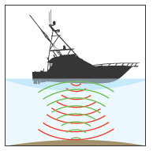
Echolocations
Dolphins and bats use echolocations to move and hunt.
Real Life Batman
http://www.youtube.com/watch?v=r9mvRRwu5Gw

Slide 13
Echolocations
Doppler Effect: A change in frequency that occurs when sound is moving relative to a listener.
https://www.youtube.com/watch?v=h4OnBYrbCjY
https://www.youtube.com/watch?v=a3RfULw7aAY

Slide 14
The Doppler Effect
This means that there will be a change in pitch based on where you are standing and where the sound is moving to.
As the object producing the sound comes closer, you will hear a higher pitch sound.
As the object producing the sound moves further away, you will hear a lower pitch sound.

